Slide 1
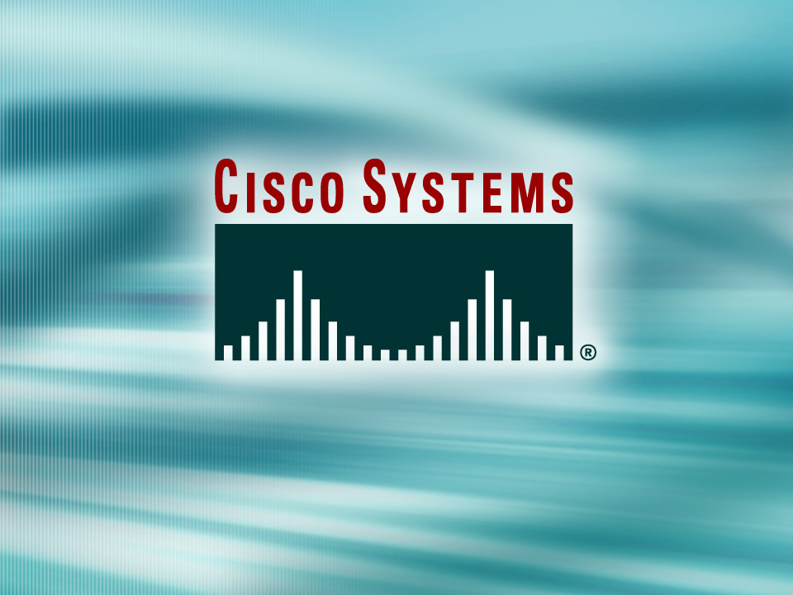
© 2002, Cisco Systems, Inc. All rights reserved.

Slide 2
Completing ISDN Calls
Module 9
Notes:
Purpose: This chapter introduces the Cisco IOS™ CLI on the Catalyst® 1900 switch and router.
Timing: This chapter should take about 2 hours to present.
Note: The Catalyst 1900 switch only has a subset of the router Cisco IOS commands available.
Contents:
Introduction to Cisco IOS. Explain to the student what is IOS?
Cisco Device startup procedures in general.
IOS configuration source.
General introduction to the IOS CLI.
Cat 1900 switch startup procedures.
Intro to Cat 1900 CLI. This part covers the basic configuration on the switch, like setting the IP address and hostname. More details about the various Cat 1900 switch configuration commands are explained in Chapter 6 and 7.
Router startup procedures. More details on the router startup process is discussed in chapter 5.
Router IOS CLI.

Slide 3
Objectives
Upon completing this module, you will be able to:
  Configure ISDN BRI, ISDN PRI, and legacy DDR, given a functioning remote access router and a physical ISDN connection
  Use show commands to identify the anomalies in the ISDN BRI, ISDN PRI, and legacy DDR configurations, given a functioning remote access router and a physical ISDN connection
  Use debug commands to identify the anomalies in the ISDN BRI, ISDN PRI, and legacy DDR configurations, given a functioning remote access router and a physical ISDN connection
Notes:
Slide 1 of 2
Purpose: This slide states the chapter objectives.
Emphasize: Read or state each objective so that each student has a clear understanding of the chapter objectives.
Note: Catalyst switches have different CLIs. The Catalyst 2900xl and the Catalyst 1900 has a Cisco IOS CLI. The Cisco IOS CLI commands available on the 2900xl is different from the 1900. The Catalyst 5000 family has no Cisco IOS CLI, and use the set commands instead. This class only covers the configuration on the Catalyst 1900 switch.

Slide 4

Configuring ISDN BRI and PRI
© 2002, Cisco Systems, Inc. All rights reserved.
Notes:
Purpose: This chapter introduces the Cisco IOS™ CLI on the Catalyst® 1900 switch and router.
Timing: This chapter should take about 2 hours to present.
Note: The Catalyst 1900 switch only has a subset of the router Cisco IOS commands available.
Contents:
Introduction to Cisco IOS. Explain to the student what is IOS?
Cisco Device startup procedures in general.
IOS configuration source.
General introduction to the IOS CLI.
Cat 1900 switch startup procedures.
Intro to Cat 1900 CLI. This part covers the basic configuration on the switch, like setting the IP address and hostname. More details about the various Cat 1900 switch configuration commands are explained in Chapter 6 and 7.
Router startup procedures. More details on the router startup process is discussed in chapter 5.
Router IOS CLI.

Slide 5
Objectives
Upon completing this lesson, you will be able to:
  Configure ISDN BRI and ISDN PRI, given a functioning router and a physical ISDN connection
  Use show commands to identify the anomalies in the ISDN BRI and PRI configurations, given a functioning router and a physical ISDN connection
  Use debug commands to identify the anomalies in the ISDN BRI and PRI configurations, given a functioning remote access router and a physical ISDN connection
Notes:
Slide 1 of 2
Purpose: This slide states the chapter objectives.
Emphasize: Read or state each objective so that each student has a clear understanding of the chapter objectives.
Note: Catalyst switches have different CLIs. The Catalyst 2900xl and the Catalyst 1900 has a Cisco IOS CLI. The Cisco IOS CLI commands available on the 2900xl is different from the 1900. The Catalyst 5000 family has no Cisco IOS CLI, and use the set commands instead. This class only covers the configuration on the Catalyst 1900 switch.

Slide 6
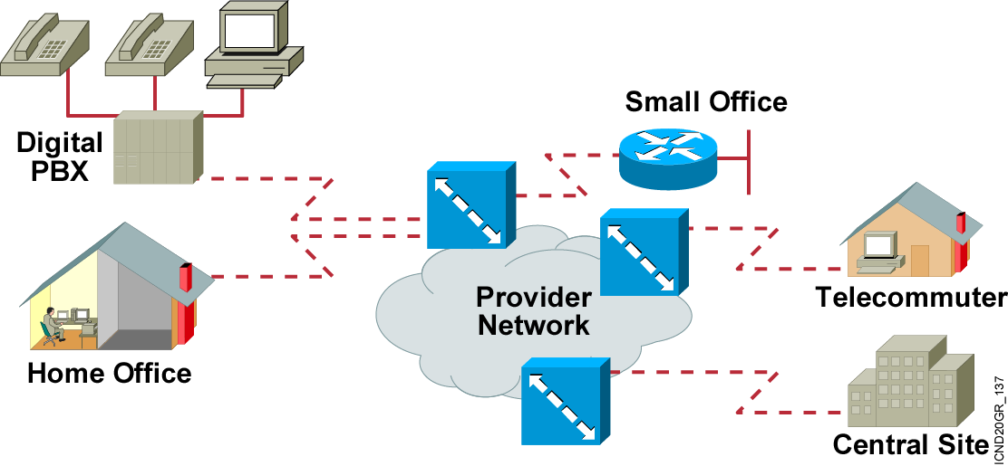
What Is ISDN?
Voice, data, video, and special services
Notes:
Purpose: This figure describes various ISDN environments.
Emphasize: The icons in the cloud represent ISDN switches. The figure displays different sites that may use ISDN.

Slide 7
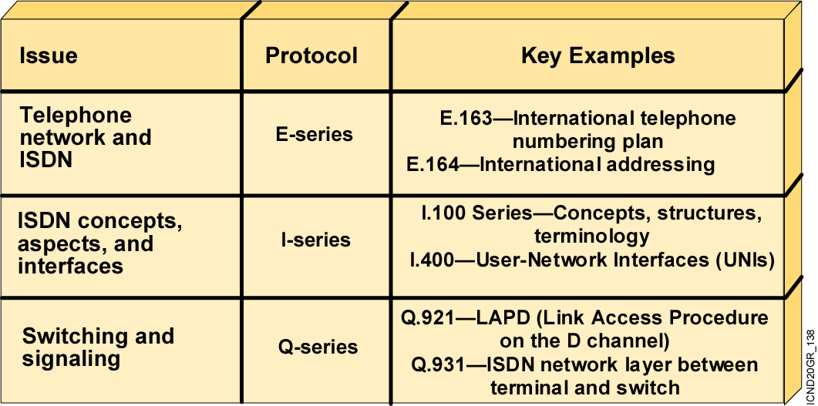
ISDN Standards
  Standards from the ITU-T (formerly CCITT)
Notes:
Purpose: This figure describes the ISDN standards.
Emphasize: The following ISDN standards relate back to the ISO/OSI model:
Layer 3—The ITU-T Q.931 provides a network-layer protocol. This ISDN call control protocol follows the ITU-T recommendations for the ISDN signaling layer. Signaling information is sent so the network will operate correctly. ISDN uses out-of-band signaling, even from home to the central office. There are many variations on how a provider’s switch implements Q.931. At this layer, ISDN addressing generally follows conventions from E.164.
Layer 2— In the ITU-T Q.921 LAPD data link protocol, the recommendation specifies the framing format for the ISDN call control message (in other words, LAPD encapsulated the Q.931 signaling message).
Layer 1—The ITU-T I.430/I.431 recommendation specifies the ISDN physical-layer interfaces: I.430 for the basic interface, and I.431 for the primary interface.

Slide 8
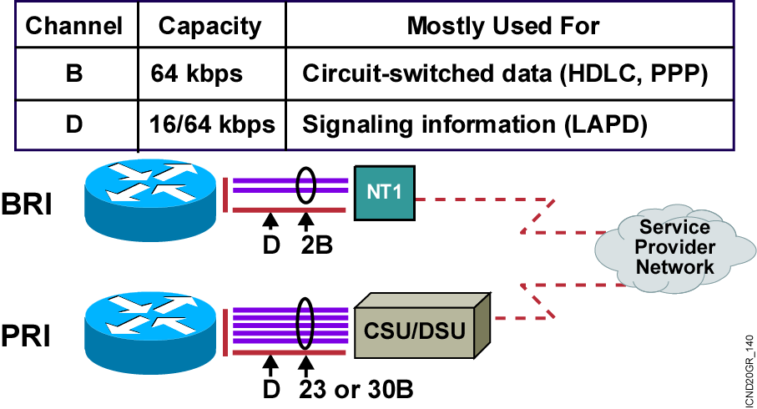
ISDN Access Options
BRI and PRI are used globally for ISDN.
Notes:
Purpose: This figure explains BRI and PRI.
Emphasize: Be aware of geographic variations regarding ISDN services. With PRI, for example, there are 23 B channels in the United States and Japan, and 30 in Europe.
Highlight that LAPD is the data link protocol on the D channel, and PPP is typically seen on the B channels.

Slide 9
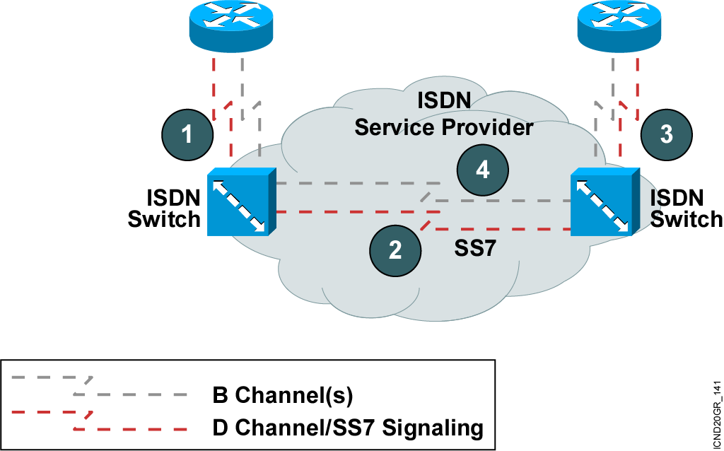
BRI and PRI Call Processing
Notes:
Purpose: This figure describes the ISDN BRI call setup process.
Emphasize: The D channel is always up. The D channel is the signaling channel. The B channels are used to send data.

Slide 10
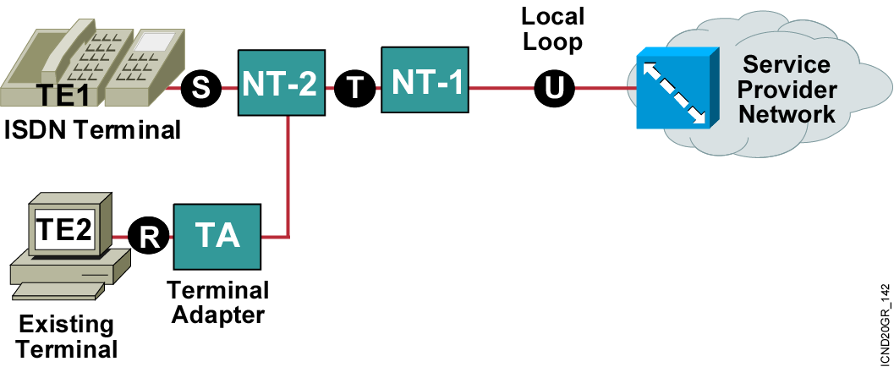
ISDN Functions and Reference Points
Functions are devices or hardware.
Reference points are demarcations or interfaces.
Notes:
Purpose: This figure highlights ISDN hardware standards and reference points.
Emphasize: The TE1 designates a native ISDN device that can connect directly to its S/T interface. The TE1 characterizes a Cisco router that has a BRI.
The NT1 is a required external device that converts the 4-wire connection on the T interface to a 2-wire U line interface. The U interface also ensures rate conversion, clock synchronization, frame alignment, and adequate power supply, and provides an operational and maintenance control point for the service provider.
The TE2 designates a non-native ISDN device that requires a TA for its S interface signals. The TE2 characterizes a Cisco router without a BRI.
The TA is an external device required on non-native ISDN devices. The TA adapts the standard R-type device signals (RS-232, V.35, and so on) for the ISDN S/T interface. The S interface enables the connection for user devices and provides access to the useful transmission rate (for example, 144 kbps for BRI). The T interface corresponds to the S interface from the provider perspective. The T interface offers the total transmission rate (for example, 192 kbps from 2B x 64 + 1D x 16 + 1Y x 48).
There is also a V interface that is part of the ISDN cloud. It is not covered here because it does not affect the CPE side of the connection.

Slide 11
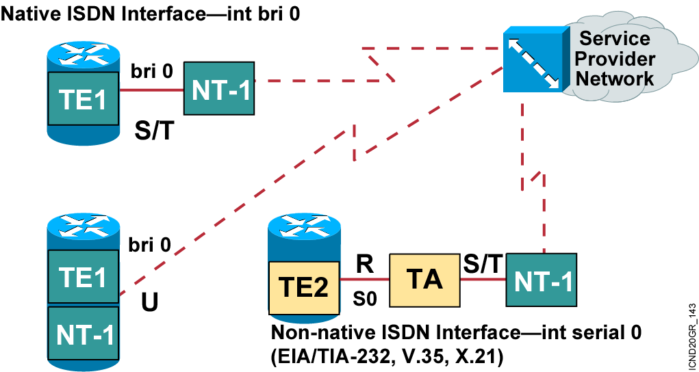
Cisco ISDN BRI Interfaces
Notes:
Purpose: This figure further highlights ISDN hardware standards and reference points for native and non-native ISDN devices.
Emphasize: As non-native ISDN devices, TE2s lack an ISDN BRI interface. To configure this device, add an external TA to the serial interface; the TA contains the BRI S/T interface.
If the router does not have an NT1 interface, an external one must be provided. A simple way to check if the router is equipped with a built-in NT1 is to check if it has an S/T or U interface. If the router has an S/T interface, it does not have a built-in NT1. If it has a U interface, it has a built-in NT1.
Note: Never connect a router with a U interface to an NT1 device because it could result in problems with the hardware.

Slide 12
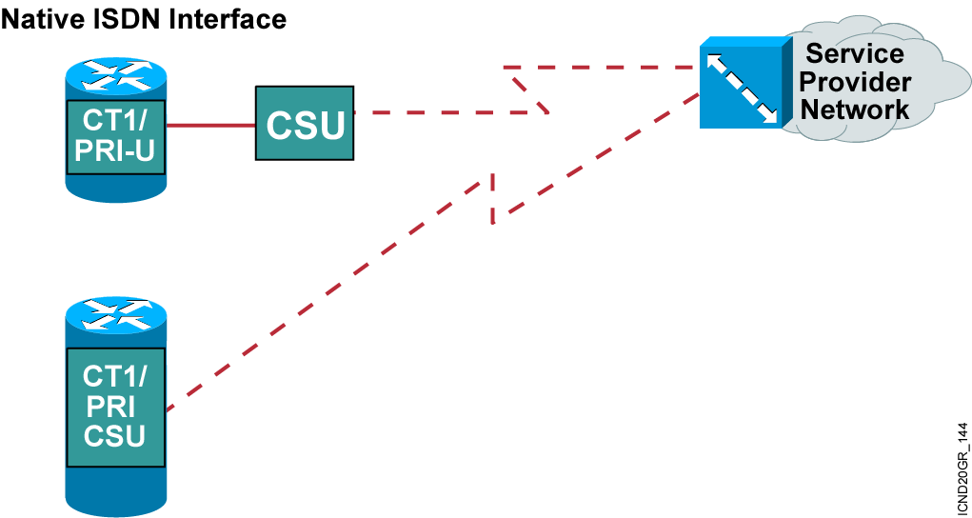
Cisco ISDN PRI Interfaces
Notes:
Purpose: This figure further highlights ISDN hardware standards and reference points for native and non-native ISDN devices.
Emphasize: As non-native ISDN devices, TE2s lack an ISDN BRI interface. To configure this device, add an external TA to the serial interface; the TA contains the BRI S/T interface.
If the router does not have an NT1 interface, an external one must be provided. A simple way to check if the router is equipped with a built-in NT1 is to check if it has an S/T or U interface. If the router has an S/T interface, it does not have a built-in NT1. If it has a U interface, it has a built-in NT1.
Note: Never connect a router with a U interface to an NT1 device because it could result in problems with the hardware.

Slide 13
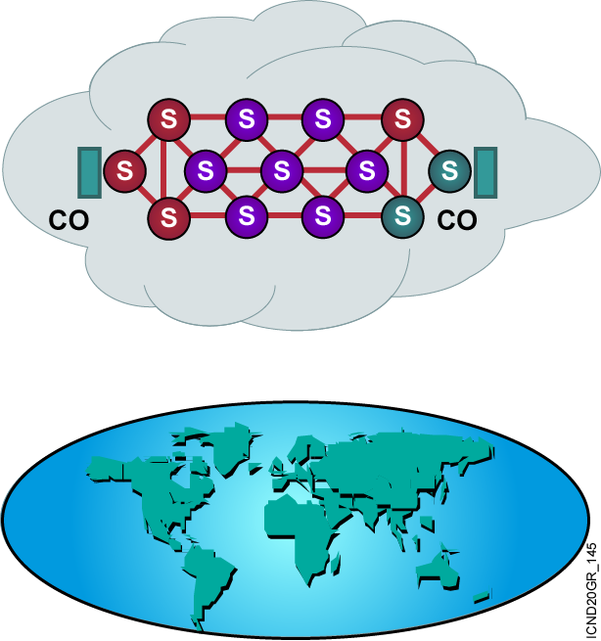
ISDN Switch Types
Many providers use many different switch types.
Services vary by region and country.
Notes:
Purpose: The figure introduces an overview of ISDN switches.
Emphasize: The figure shows two representations of the ISDN world. In the top image, the cloud represents the providers by using different colors for the various switches they use.
An example of switch diversity occurs in Western Europe where all PTTs now offer ISDN. Despite efforts to adopt a common Euro-ISDN standard, switches in one nation may not easily interoperate with switches in another nation. Early adopters of ISDN, such as France, face major equipment upgrade efforts before they fully accommodate the European Telecommunication Standards Institute (ETSI) specifications.
For the administrator, a key requirement is to configure for compatibility with the switch on the ISDN local loop—the end-user ISDN device connected to the ISDN switch in the provider’s central office.
The lower image shows the globe and continental geographic representations to indicate the worldwide scope of ISDN standards-based networks. The bullet cautions that services and prices vary. ISDN coverage is not as seamless as it might appear on paper.
Note: Switch variations complicating ISDN switch configuration occur because of the different approaches used by ISDN providers at the network-layer functions between the terminal and the switch. Q.931 is the most prevalent protocol used for this network-layer function.

Slide 14
Configuring ISDN BRI
Step 1: Specify the ISDN switch type.
Router(config)#isdn switch-type switch-type
Router(config-if)#isdn switch-type switch-type
The command specifies the type of ISDN switch with which the router communicates.
Other configuration requirements vary for specific providers.
Notes:
Slide 1 of 2
Purpose: This figure describes how to configure the switch type.
Emphasize: The service provider must tell you what switch type it is using, or emulating, and what the SPIDs are.
The figure shows the command to specify the ISDN switch type. In newer versions of Cisco IOS, the switch type can also be configured at the interface level.
Note: If you need to change the switch type specified, you may need to reboot the router before the different switch type takes effect on the router.
Some service providers may use one switch type but emulate another. The switch type that must be configured is the one that is emulated.

Slide 15
Configuring ISDN BRI (cont.)
Step 2: (Optional) Setting SPIDs
Router(config-if)#isdn spid1 spid-number [ldn]
  Sets a B channel SPID required by many service providers
Router(config-if)#isdn spid2 spid-number [ldn]
  Sets a SPID for the second B channel
Notes:
Slide 2 of 2
Purpose: This figure describes how to configure SPIDs.
Emphasize: The isdn spid1 and isdn spid2 commands are used on some switches and are replacements for subaddresses.
Some service providers require SPIDs to authenticate that a call requests are within contract specifications. SPIDs are required for National ISDN-1 and DMS-100 ISDN switches.
Some service providers require that both spid1 and spid2 be specified, while others only require spid1.

Slide 16
Configuring ISDN PRI
Step 1: Specify the ISDN switch type.
Router(config)#isdn switch-type switch-type
Step 2: Select the controller.
Router(config)#controller controller slot/port
Step 3: Establish the interface port
to function as PRI .
Router(config-controller)#pri-group timeslots range

Slide 17
ISDN PRI Examples
T1 Sample Configuration
Router(config)#controller T1 3/0
Router(config-controller)#framing esf
Router(config-controller)#linecode b8zs
Router(config-controller)#pri-group timeslots 1-24
Router(config-controller)#interface Serial3/0:23
Router(config-if)#isdn switch-type primary-5ess
Router(config-if)#no cdp enable
E1 Sample Configuration
Router(config)#controller E1 3/0
Router(config-controller)# framing crc4
Router(config-controller)# linecode hdb3
Router(config-controller)# pri-group timeslots 1-31
Router(config-controller)#interface Serial3/0:15
Router(config-if)# isdn switch-type primary-net5
Router(config-if)# no cdp enable

Slide 18
Verifying the ISDN Configuration
Router#show isdn active
Displays current call information
Router#show interfaces bri0
Displays statistics for the BRI interface configured on the router
Router#show isdn status
Displays the status of an ISDN connection

Slide 19
Troubleshooting the ISDN Configuration
Router#debug isdn q921
Shows ISDN Layer 2 messages
Router#debug isdn q931
Shows ISDN call setup and teardown activity (Layer 3)
Router#debug ppp authentication
Displays the PPP authentication protocol messages
Router#debug ppp negotiation
Displays information on PPP link establishment
Router#debug ppp error
Displays protocol errors associated with PPP

Slide 20
Summary
  ISDN defines a digital architecture that provides integrated voice and data capability using the public switched network.
  ISDN specifies two standard access methods, BRI
  and PRI.
  To establish an ISDN call, the D channel is used between the routers and switches, and SS7 signaling is used between the switches.
  ISDN functions are hardware devices while reference points are interfaces between devices.
  Cisco devices can be physically configured with different ISDN options, which dictate what additional equipment, if any, is needed to run ISDN.
Notes:
Purpose: This slide discuss the initial configurations on the routers and switches.
Note: There is no setup mode on the Catalyst 1900 switch.

Slide 21
Summary (Cont.)
  You must configure your router to identify the type of switch it will be communicating with, which depends in part on the country the
  switch is in.
  To enable ISDN BRI, you use isdn switch-type and isdn spid commands.
  To enable ISDN PRI, use the pri-group command.
  Use show commands to verify that your ISDN configuration is functioning properly.
  You can use debug commands to troubleshoot your ISDN configuration.
Notes:
Purpose: This slide discuss the initial configurations on the routers and switches.
Note: There is no setup mode on the Catalyst 1900 switch.

Slide 22


